Slide 1
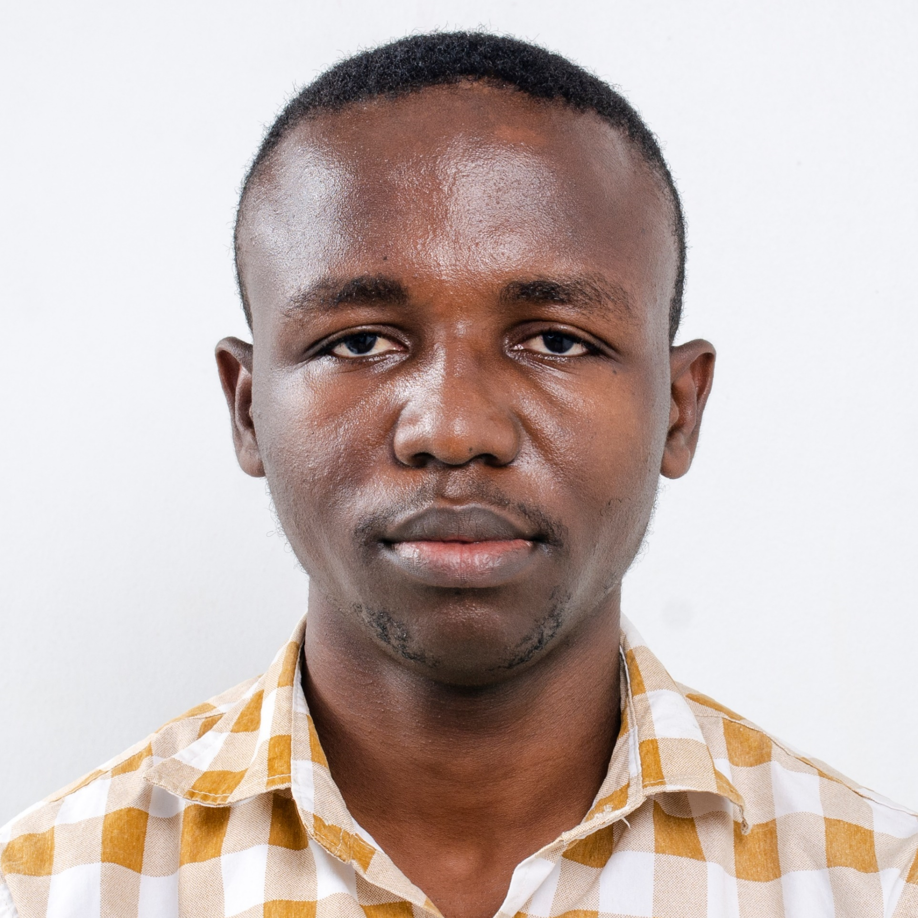
Programming: Variables
Robert Doe
INSTRUCTOR
@bobcumulus www.codeden.org

Slide 2
Variables
“Variables are storage containers in a computer’s memory, given special names and they store values during the execution of an instruction or a program

Slide 3
What goes on during program execution?
Output
Input
Processing
Storage

Slide 4

Variables
Bob
Male
53
Name
Sex
Age

Slide 5



Real World Application
(Mathematics)
Question 1.
Solomon spent GHC180.00 to buy 3 hockey sticks. If each hockey stick was the same price, how much did 1 cost?
Solution
Let X represent cost of hockey stick
$$180=3×X$$
$$X=\frac{180}{3}$$
$$X=GHC 60.00$$

Slide 6
Short Story
Every computer user interacts with a computer program each day.
As we interact the computer, it displays prompts / messages on the screen and we respond to such
messages with inputs.
The computer takes our inputs and stores it in a container in memory.
These containers are known as variables.
The values would be in the container for as long as the program runs.
The data we give to the computer can be of different types.
Before a program can use a variable, the program would have to reserve the space.

Slide 7
Naming a variable
1. Must start with an underscore or and English alphabetical letter
2. Must not be a reserved word
3. Must be short and meaningful
4. Must not contain any special character
(>?.,…)
5. Can be followed by a mixture of characters after the first letter as in rule 1

Slide 8
Naming Formats
Camel Casing
E.g. nameOfStudent
Pascal Casing
E.g. NameOfStudent
Snake Casing
E.g. name_of_student

Slide 9
Valid Variable Names
Lambda
2asterisk
D.O.B
_name_of_student
#ageOfClient
$height
when
while
if
dateOfBirth
typeOfFabric
size_of_shoe
Name2
Sur name
Married?
Valid
Invalid
Invalid
Valid
Invalid
Invalid
Valid
Invalid
Invalid
Valid
Valid
Valid
Valid
Invalid
Invalid

Slide 10
Datatypes
String
Number
Boolean
Character

Slide 11
String
“Most programming languages have a data type called a string, which is used for data values that are made up of ordered sequences of characters. They are mostly surrounded by double
quotes in most programming languages.

Slide 12
Number
“All numeric data are grouped under this particular datatype. Under this sections we have
all type of data ranging from decimals to integers.

Slide 13
Boolean
“A Boolean data can be either true or false.

Slide 14
Character
“Symbols, letters and numbers are collectively referred to as characters in programming.
They exist as single values and are surrounded by single quotes in most languages.

Slide 15
Examples
DATATYPE | EXAMPLES
String | “ SANDRA ”, “Ghana”, “ 923 ”, “0271302702” “WS-018-100”, “I am two years old”, “SDA” “KNUST”, “Palm nut soup” , etc.
Number | 1234, 50.6, 99.2 , 5/7 , 20.333333, 1000 , etc.
Boolean | True or False
Character | ‘F’, ‘M’, ‘$’ , ‘ ’, ‘9’, ‘ . ’, ‘/’, etc.

Slide 16

Activity
Write 10 variable names under each of the datatypes that we have learnt so far.
NB: Make sure each of your variable names given rules in the slide

Slide 17
NUMBER | CHARACTER | STRING | BOOLEAN
age | bloodGroup | colour_of_shirt | hasEaten
height | size | nameOfParent | isMarried
 | sex |  | canPlay
 |  |  | wasBeaten

Slide 18
robertdoe@codeden.org

